Slide 1
SYSTEMIC HYPERTENSION
By
Dr. Mahadevi A.L
Assistant professor
Dept of Paediatrics
24-05-2021

Slide 3
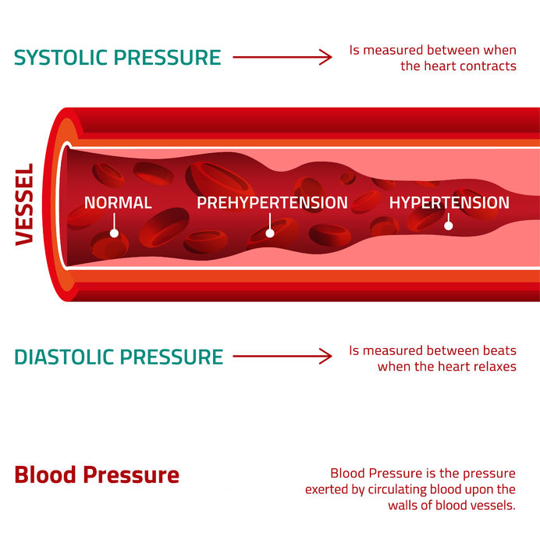

Slide 4
Primary (essential) hypertension occurs frequently in adults and, if untreated, is a major risk factor for myocardial infarction, cerebro vascular accident (stroke), and renal failure.
In adults with hypertension, a 5 mm Hg increase in diastolic blood pressure (BP) increases the risk of coronary artery disease by 20% and the risk of stroke by 35%.
Furthermore, along with diabetes, hypertension is 1 of the 2 leading causes of end-stage renal disease in adults.
The prevalence of adult hypertension increases with age, ranging from 15% in young adults to 60% in individuals older than 65 yr.

Slide 5
Hypertensive children, although frequently asymptomatic, already may manifest evidence of target organ damage.
Up to 40% of hypertensive children have left ventricular hypertrophy, and hypertensive children have increased carotid intima-to-media thickness, a marker of early atherosclerosis.
Primary hypertension occurring during childhood often continues into adulthood.
Children with BP >90th percentile exhibit a 2.4-fold greater risk of having hypertension as adults. Similarly, almost half of hypertensive adults had a BP>90th percentile as children.
Adolescent hypertension is also an independent predictor of both end-stage renal disease and left ventricular dysfunction in middle-aged men.

Slide 6
Prevalence of Hypertension in Children
In infants and young children, systemic hypertension is uncommon, with a prevalence of <1% but, when present often indicates an underlying disease process (secondary hypertension ).
Severe and symptomatic hypertension in children is usually caused by secondary hypertension.
In contrast, the prevalence of primary hypertension, mostly in older school-age children and adolescents, has increased in prevalence in parallel with the obesity epidemic.

Slide 7
Estimates are variable, but recent data from the U.S. National Health and Nutrition Examination Survey (NHANES) show that approximately 9% of American youth have prehypertension and 3-4% have hypertension.
The influence of obesity on elevated BP is evident in children as young as 2-5 yr old.
Approximately 20% of American youth are obese, and up to 10% of obese youth have hypertension.

Slide 8
Definition of Hypertension
Normal BP in adults is 120/80 mm Hg (or lower).
Elevated blood pressure is considered systolic BP of 120-129 and diastolic BP <80 mm Hg.
Stage 1 hypertension is systolic 130-139 or diastolic 80-89 mm Hg;
Stage 2 is systolic ≥140 or diastolic ≥90 mm Hg.
Hypertension-associated cardiovascular events (e.g., MI, stroke) occur rarely in childhood, the definition of hypertension in children is statistical and based on the distribution of BP in healthy children, not outcomes.

Slide 9
The clinical practice guideline on childhood hypertension, issued by the American Academy of Pediatrics (AAP) in 2017, maintains the same Statistical approach to defining and categorizing childhood BP as in previous guidelines from the National High Blood Pressure Education Program (NHBPEP) :
Normal BP: BP <90th percentile for age, sex, and height; or <120/<80 (systolic/diastolic) mm Hg for adolescents ≥13 yr old
Elevated BP: BP reading ≥90th percentile and <95th percentile for age, sex, and height; or 120-129/<80 mm Hg for adolescents ≥13 yr old
Hypertension: BP >95th percentile for age, sex, and height; or ≥130/80 mm Hg for adolescents ≥13 yr old.

Slide 10
Hypertensive-level BP is further staged as follows:
Stage 1 hypertension: BP >95th percentile for age, sex, and height up to the 95th percentile + 11 mm Hg; or 130-139/80-89 mm Hg for adolescents ≥13 yr of age
Stage 2 hypertension: BP ≥95th percentile + 12mm Hg for age, sex, and height; or >140/90 mm Hg for adolescents ≥13 yr of age

Slide 11
The BP cut points for adolescents ≥13 yr old and the use of the term elevated BP in the AAP guideline were chosen to correspond to revised BP cut points and terminology found in the American Heart Association/American College of Cardiology (AHA/ACC) guideline for adult hypertension.
The 2016 European Society of Hypertension (ESH) pediatric BP guideline also suggested that an absolute BP cutoff be used for adolescents age 16 and older, rather than using BP percentiles.
For these older adolescents, the ESH guidelines define high-normal BP as 130-139/85-89 mm Hg, and hypertension as ≥140/90 mm Hg.

Slide 12
The 2017 AAP guideline also contains new tables of normative BP values for children and adolescents based on a reanalysis of the NHBPEP database, removing all overweight and obese children.
This revision results in BP values that are 2-3 mm Hg lower than the corresponding BP values in the 2004 NHBPEP.
The 2017 AAP guideline also contains a simplified table of BP values that may require further evaluation, which should be useful for screening.

Slide 13
Blood Pressure Measurement in Children
The 2017 AAP guideline recommends that children 3 yr or older should have their BP measured during annual preventive visits, unless the child has risk factors such as obesity, chronic kidney disease (CKD), or diabetes, in whom it should be checked at every healthcare encounter.
In contrast, the 2016 ESH pediatric guideline recommends checking BP at every healthcare encounter for all children >3 yr old.
Selected children <3 yr old should also have their BP measured, including those with a history of prematurity, congenital heart disease, renal disease, solid-organ transplant, cancer, treatment with drugs known to raise BP, other illnesses associated with hypertension (e.g., neurofibromatosis, tuberous sclerosis), or evidence of increased intracranial pressure.
The preferred method is by auscultation using a sphygmomanometer (BP) cuff appropriate for the size of the child's arm.

Slide 15
Elevated readings should be confirmed on repeat visits before determining that a child is hypertensive.
The BP should be measured with the child in the seated position after a period of quiet for at least 5 min, and it is recommended that the BP is checked 3 times, averaging the results.
Careful attention to cuff size is necessary to avoid over diagnosis, because a cuff that is too short or narrow artificially increases BP readings.
An appropriate-sized cuff has an inflatable bladder whose length covers 80–100% of the upper arm circumference (measured midway between the acromion process and olecranon) and whose width is at least 40% of the arm circumference.
A wide variety of cuff sizes should be available in any medical office where children are routinely seen.

Slide 17
Systolic blood pressure (SBP) is indicated by appearance of the first Korotkoff sound.
Diastolic blood pressure (DBP) has been defined by consensus as the fifth Korotkoff sound, unless the Korotkoff sounds can be heard down to 0 mm Hg, in which case the fourth Korotkoff sound should be reported as the DBP.
Palpation is useful for rapid assessment of SBP, although the palpated BP is generally about 10 mm Hg lower than that obtained by auscultation.
Oscillometric techniques are used frequently in infants and young children, but they are susceptible to artifacts and are best for measuring mean arterial pressure (MAP).
In addition, different devices use different proprietary algorithms to back calculate SBP and DBP from the MAP, making comparison between devices difficult.

Slide 18
Ambulatory Blood Pressure Monitoring
Ambulatory blood pressure monitoring (ABPM ) is frequently used as a tool to assess pediatric hypertension.
The patient wears a device that records BP every 20-30 min, throughout a 24 hr period, during usual daily activities, including sleep. This monitoring allows calculation of the mean daytime BP, sleep BP, and mean BP over 24 hr.
The physician can also determine the proportion of BP measurements that are in the hypertensive range (BP load) and whether there is an appropriate decrease in BP during sleep (nocturnal dip), generally considered normal if there is a decrease in nocturnal BP of >10% from awake values.
The cuff should be placed on the patient's non dominant arm.
It is recommended that the patient keep a journal of sleep and awake times, medication timing, and other events that may be relevant to BP readings.
Clinicians should only perform ABPM if they have had specific training in performing interpreting the results.

Slide 19
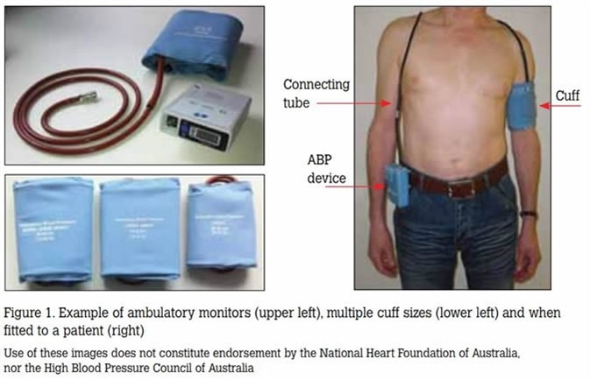

Slide 20
ABPM readings are more strongly correlated with target-organ damage in children than casual/office BP readings; the 2017 AAP guideline strongly recommends that ABPM be performed on all patients with elevated office readings in order to confirm the diagnosis of hypertension.
In addition, ABPM is necessary to diagnose white coat hypertension (elevated office BP but normal ambulatory BP) as well as masked hypertension (normal office BP but elevated ambulatory BP).
ABPM is also a useful tool for evaluating effectiveness of antihypertensive therapy. ABPM is also recommended to assess BP patterns in high-risk patient populations, such as children with CKD, solid-organ transplant, diabetes mellitus, and severe obesity.

Slide 21
ABPM is an extremely useful tool for evaluating and managing hypertension in appropriate patient populations, but it does have limitations.
Not every patient will tolerate APBM, including younger children (although there are reports of successful ABPM in toddlers 18 mo old) and some children with developmental delay.
Nonetheless, it is feasible to perform ABPM in children ≥6-7 yr.
The most accepted normative data come from the German Working Group on Pediatric Hypertension.

Slide 22
However, there are concerns with this dataset:
(1) it includes only central European Caucasian children and thus might not be generalizable to other ethnicities;
(2) there were relatively few shorter children included, which may limit its application to patients with chronic diseases such as CKD; and
(3) there was very little variability in DBP values, which is not consistent with data from other BP measurement techniques showing that DBP varies with both age and height.

Slide 23
Etiology and Pathophysiology
Blood pressure is the product of cardiac output (CO) and peripheral vascular resistance (PVR).
An increase in either CO or PVR results in an increase in BP; if either of these factors increases while the other decreases, BP may not increase.
When hypertension is the result of another disease process, it is referred to as secondary hypertension.
When no identifiable cause can be found, it is referred to as primary hypertension.

Slide 24
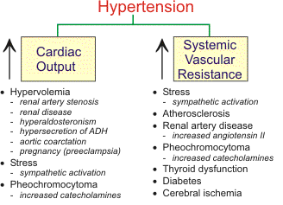

Slide 25
Secondary hypertension is most common in infants and younger children.
It is most often caused by renal abnormalities; additional etiologies include cardiovascular disease and endocrinopathies.
Younger age, severely elevated BP, and symptomatic hypertension make a secondary cause of hypertension more likely.
Many childhood diseases can be responsible for chronic hypertension or acute/intermittent hypertension . The most likely cause varies with age.
Hypertension in the premature infant is sometimes associated with umbilical artery catheterization, renal artery thrombosis, or bronchopulmonary dysplasia.
Hypertension during early childhood may be caused by renal disease, coarctation of the aorta, endocrine disorders, or medications.

Slide 27
Conditions Associated With Chronic Hypertension in Children
Renal
Recurrent pyelonephritis/renal scarring
Chronic glomerulonephritis
Prematurity
Congenital dysplastic kidney
Polycystic kidney disease
Vesicoureteral reflux nephropathy
Segmental hypoplasia (Ask-Upmark kidney)
Obstructive kidney disease
Renal tumors
Renal trauma
Systemic lupus erythematosus (other connective tissue diseases)

Slide 28
Vascular
Coarctation of thoracic or abdominal aorta
Renal artery lesions (stenosis, fibromuscular dysplasia, thrombosis,
aneurysm)
Umbilical artery catheterization with thrombus formation
Neurofibromatosis (intrinsic or extrinsic narrowing for vascular lumen)
Renal vein thrombosis
Vasculitis (ANCA associated, polyarteritis nodosa, Takayasu arteritis)
Arteriovenous shunt
Williams-Beuren syndrome
Moyamoya disease

Slide 29
Endocrine
Hyperthyroidism
Congenital adrenal hyperplasia (11β-hydroxylase and 17-hydroxylase
defect)
Cushing syndrome
Primary hyperaldosteronism
Apparent mineralocorticoid excess
Glucocorticoid remedial aldosteronism (familial aldosteronism type 1)
Glucocorticoid resistance (Chrousos syndrome)
Pseudohypoaldosteronism type 2 (Gordon syndrome) Pheochromocytoma
Other neural crest tumors (neuroblastoma, ganglioneuroblastoma,
ganglioneuroma)
Liddle syndrome
Geller syndrome

Slide 30
Central Nervous System
Intracranial mass
Hemorrhage
Residual following brain injury
Quadriplegia (dysautonomia)
Sleep disordered breathing
ANCA, Antineutrophil cytoplasmic antibody.

Slide 31
Conditions Associated With Transient or Intermittent Hypertension in Children
Renal
Acute postinfectious glomerulonephritis
Henoch-Schönlein purpura with nephritis
Hemolytic-uremic syndrome
Acute kidney injury
After renal transplantation (immediately and during episodes of rejection)
Hypervolemia
Pyelonephritis
Renal trauma
Leukemic infiltration of the kidney

Slide 32
Drugs and Poisons
Cocaine
Oral contraceptives
Sympathomimetic agents
Amphetamines
Phencyclidine
Corticosteroids and adrenocorticotropic hormone
Cyclosporine, sirolimus, or tacrolimus treatment after transplantation

Slide 33
Central and Autonomic Nervous System
Increased intracranial pressure
Guillain-Barré syndrome
Burns
Familial dysautonomia
Stevens-Johnson syndrome
Posterior fossa lesions
Porphyria
Poliomyelitis
Encephalitis
Spinal cord injury (autonomic storm)

Slide 34
Miscellaneous
Preeclampsia
Pain, anxiety
Hypercalcemia
After coarctation repair
White blood cell transfusion
Extracorporeal membrane oxygenation
Renal disease (e.g., chronic glomerulonephritis, reflux or obstructive nephropathy, hemolytic-uremic syndrome, polycystic kidney disease, congenital anomalies of the kidney and urinary tract) and renovascular hypertension account for approximately 90% of children with secondary hypertension.
Renal parenchymal disease and renal artery stenosis lead to water and sodium retention thought to be, in part, secondary to increased renin secretion.

Slide 36
Adrenocortical disorders (e.g., aldosterone-secreting tumors, sodium-retaining congenital adrenal hyperplasia, Cushing syndrome) may produce hypertension in patients with increased mineralocorticoid secretion.
It is important to consider conditions associated with real or apparent mineralocorticoid excess and thus a suppressed renin level (with or without hypokalemia) form of secondary hypertension.
Pheochromocytomas are catecholamine-secreting tumors that give rise to hypertension because of the cardiac and peripheral vascular effects of epinephrine and norepinephrine.
Children with pheochromocytoma usually have sustained rather than intermittent or exercise-induced hypertension.

Slide 37
Pheochromocytoma develops in approximately 5% of patients with neurofibromatosis and can also be seen in certain genetic disorders such as von Hippel–Lindau disease.
Rarely, secondary hypertension can be caused by pseudohyperaldosteronism , which leads to elevated BP in the face of a suppressed renin level.
Such disorders include Liddle syndrome, apparent mineralocorticoid excess, and glucocorticoid-remediable aldosteronism.

Slide 38
Altered sympathetic tone can be responsible for acute or intermittent elevation of BP in children with Guillain-Barré syndrome, poliomyelitis, burns, and Stevens- Johnson syndrome.
Intracranial lesions also affect sympathetic outflow from the central nervous system.
Coarctation of the aorta must always be considered.
Several endocrinopathies are associated with hypertension, usually those involving the thyroid, parathyroid, and adrenal glands.
Systolic hypertension and tachycardia are common in hyperthyroidism; DBP is not usually elevated.
Hypercalcemia , whether secondary to hyperparathyroidism or other causes, often results in mild elevation in BP because of an increase in vascular tone.

Slide 39
Clinical Findings in Patients With Mineralocorticoid Excess
CONDITION & CLINICAL PRESENTATION
CAH: 11β-hydroxylase Deficiency- Early growth spurt initially, then short adult stature, advanced bone age, premature adrenarche, acne, precocious puberty in males, amenorrhea/hirsutism/virilism in females (autosomal recessive)
CAH: 17α-hydroxylase deficiency- Pseudohermaphroditism (male), sexual infantilism (female) (autosomalrecessive)
Apparent mineralocorticoid excess- Growth retardation/short stature, nephrocalcinosis (autosomal recessive)

Slide 40
Liddle syndrome -Severe hypertension, hypokalemia, and metabolic alkalosis, muscle weakness (autosomal dominant)
Geller syndrome (exacerbated by pregnancy)- Early onset of hypertension (before age 20 yr), exacerbated in pregnancy
Glucocorticoid remediable aldosteronism (GRA) (familial aldosteronism type 1) -Early onset of hypertension, presence of family history of mortality or morbidity from early hemorrhagic stroke (autosomal dominant)
Pseudohypoaldosteronism type2 (Gordon syndrome)- Short stature, hyperkalemic and hyperchloremic metabolic acidosis, borderline blood pressure (autosomal dominant)
Glucocorticoid resistance (children) (Chrousos syndrome)-Ambiguous genitalia, precocious puberty; women may have androgen excess: acne, excessive hair, oligo/anovulation, infertility (familial or sporadic)

Slide 41
A number of drugs of abuse , therapeutic agents , and toxins may cause hypertension.
Cocaine may provoke a rapid increase in BP and can result in seizures or intracranial hemorrhage.
Phencyclidine causes transient hypertension that may become persistent in chronic abusers.
Tobacco use may also increase BP.
Sympathomimetic agents used as nasal decongestants, appetite suppressants, and stimulants for attention-deficit disorder produce peripheral vasoconstriction and varying degrees of cardiac stimulation.
Individuals vary in their susceptibility to these effects.
Oral contraceptives should be suspected as a contributor to elevated BP in adolescent girls, although the incidence is lower with the use of low-estrogen preparations.
Immunosuppressant agents such as cyclosporine and tacrolimus cause hypertension in organ transplant recipients, and the effect is exacerbated by the co-administration of corticosteroids.
BP may be elevated in patients with poisoning by a heavy metal (lead, cadmium, mercury).

Slide 42
In older school-age children and adolescents, primary hypertension becomes increasingly common. These patients often are overweight, have a strong family history of hypertension, and have BP values at, or only slightly above, the 95th percentile for age.
Isolated systolic hypertension is also more consistent with primary hypertension, whereas diastolic hypertension may suggest a secondary cause.
The cause of primary hypertension is likely to be multifactorial;
-obesity,
-genetic alterations in calcium and sodium transport,
-vascular smooth muscle reactivity,
-the renin-angiotensin-aldosterone system (RAAS),
-sympathetic nervous system overactivity,
-and insulin resistance have been implicated in this disorder.
Elevated uric acid levels may play a role in the pathophysiology of primary hypertension, and proof-of-concept studies have confirmed that Lowering of uric acid levels results in lower BP in overweight youth with hypertension or prehypertension.
Some children and adolescents demonstrate salt-sensitive hypertension , a factor that is ameliorated with weight loss and sodium restriction.

Slide 43
Normotensive children of hypertensive parents may show abnormal physiologic responses that are similar to those of their parents.
When subjected to stress or competitive tasks, the offspring of hypertensive adults, as a group, respond with greater increases in heart rate and BP than do children of normotensive parents.
Similarly, some children of hypertensive parents may excrete higher levels of urinary catecholamine metabolites or may respond to sodium loading with greater weight gain and increases in BP than do those without a family history of hypertension.
The abnormal responses in children with affected parents tend to be greater in the black population than among white individuals.

Slide 44
Clinical Manifestations
Children and adolescents with primary hypertension are usually asymptomatic; the BP elevation is usually mild and is detected during a routine examination or evaluation before athletic participation. These children may also be obese.
Children with secondary hypertension can have BP elevations ranging from mild to severe. Unless the BP has been sustained or is rising rapidly, hypertension does not usually produce symptoms.
Therefore, clinical manifestations may instead reflect the underlying disease process, such as growth failure in children with CKD.
Children and adolescents with acute severe hypertension , in contrast, present with BP elevation well above stage 2 hypertension and severe symptoms that may represent acute target-organ injury.

Slide 45
Subclinical hypertensive target-organ injury is a common clinical manifestation in children with primary hypertension.
Using echocardiography with pediatric normative data, left ventricular hypertrophy is detected in up to 40% of hypertensive children.
Other markers of target-organ damage that have been demonstrated in hypertensive children include –
-hypertensive retinopathy,
-increased carotid intima-to-media thickness,
-and increased vascular stiffness.
Children with prehypertension also have evidence of target-organ damage, often at a magnitude intermediate between that of normotensive and hypertensive children.

Slide 46
Diagnosis
The 1st step in diagnosing hypertension is recognition of elevated BP.
BP readings taken in the office should be compared to normative BP tables, indexed by height and sex, to ensure that the patient is normotensive.
Multiple studies have shown substantial under recognition of hypertension in children and adolescents, with the medical record showing only 8–26% of pediatric patients with documented elevated BP. This may be related to the complexity of the normative tables, although other factors such as provider experience and the presence or absence of obesity have also been shown to affect recognition of elevated BP readings.
In addition to use of the simplified screening table found in the 2017 AAP guideline , this issue could also be overcome by building alerts into the electronic medical record.
Elevated office BP readings should be confirmed using ABPM to identify children with white coat hypertension, who may not require further evaluation.

Slide 48
Once the diagnosis of sustained hypertension is made, the evaluation should be directed toward uncovering potential underlying causes of the hypertension,
evaluating for comorbidities, and screening for evidence of target-organ damage.
The extent of the evaluation for underlying causes of hypertension depends on the type of hypertension that is suspected.
An extensive evaluation may be necessary when secondary hypertension is a strong consideration, such as in younger children with severe and symptomatic hypertension.
Alternatively, overweight adolescents with a family history of hypertension who have mild elevations of BP may only need limited testing.

Slide 49
In all patients, a careful history and physical examination are warranted.
Birth history should be documented to screen for prematurity and other perinatal events that may affect later BP.
A family history for metabolic disease, renal disease, early cardiovascular events, and other forms of secondary hypertension should be obtained.
Growth parameters should be determined to detect evidence of chronic disease.
BP should be obtained in all 4 extremities to detect coarctation (thoracic or abdominal) of the aorta.
identifies other features of the physical examination that may provide evidence of an underlying cause of hypertension.

Slide 50
Unless the history and physical examination suggest another cause, children with confirmed hypertension should have an evaluation to detect renal disease, including urinalysis, electrolytes, blood urea nitrogen, creatinine, and complete blood count.
Standard renal ultrasound should be considered in patients with a higher suspicion of secondary hypertension to assess for discrepancies in renal size, structural abnormalities, and other potential causes of hypertension.
Measuring serum potassium is essential because hypokalemia may be present in renovascular hypertension and many monogenic forms of hypertension (including Liddle syndrome, glucocorticoid remedial aldosteronism, and apparent mineralocorticoid excess), whereas hyperkalemia may be seen in Gordon syndrome

Slide 51
Renovascular hypertension is often associated with other diseases but may be isolated .
Magnetic resonance (MR) or computed tomography , (CT) angiography can reveal renal artery stenosis, but formal intraarterial angiography may be needed to detect intrarenal vascular stenoses and in infants and young children, in whom noninvasive imaging techniques often are not helpful because of small vessel size.
Doppler renal ultrasonography is of similar limited utility in children because of poor patient cooperation, imaging difficulties related to obesity, and operator inexperience.
Doppler renal ultrasonography has a sensitivity of approximately 60–65% in patients with renovascular disease; specificity is 95%.
CT angiography has a sensitivity and specificity of 88% and 81%, respectively, compared to 80% and 63% for MR angiography.
Doppler ultrasonography is not recommended when screening for renovascular hypertension in the 2017 AAP guideline except in selected patients

Slide 52
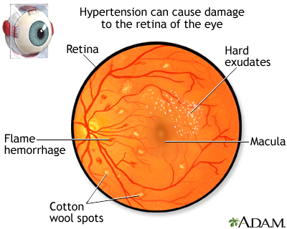

Slide 53
Findings to Look for on Physical Examination in Patients With Hypertension
PHYSICAL FINDINGS POTENTIAL RELEVANCE
GENERAL
Pale mucous membranes, edema, growth Retardation -Chronic renal disease
Elfin facies, poor growth, retardation- Williams syndrome
Webbing of neck, low hairline, widespread nipples, wide carrying angle-Turner syndrome
Moon face, buffalo hump, hirsutism, truncal obesity, striae, acne- Cushing syndrome

Slide 54
HABITUS
Thinness- Pheochromocytoma, renal disease, hyperthyroidism
Virilization- Congenital adrenal hyperplasia
Rickets- Chronic renal disease
SKIN
Café au lait spots, neurofibromas- Neurofibromatosis, pheochromocytoma
Tubers, “ash-leaf” spots- Tuberous sclerosis
Rashes- Systemic lupus erythematosus, vasculitis (Henoch-Schönlein purpura), impetigo with acute nephritis
Pallor, evanescent flushing, sweating- Pheochromocytoma
Needle tracks- Illicit drug use
Bruises, striae -Cushing syndrome
Acanthosis nigricans- Type 2 diabetes, insulin resistance

Slide 55
EYES
Extraocular muscle palsy -Nonspecific, chronic, severe
Fundal changes -Nonspecific, chronic, severe
Proptosis -Hyperthyroidism
HEAD AND NECK
Goiter- Thyroid disease
Adenotonsillar hypertrophy- Sleep-disordered breathing
Webbed neck- Turner syndrome
CARDIOVASCULAR SIGNS
Absent of diminished femoral pulses, low leg pressure relative to arm pressure -Aortic coarctation
Heart size, rate, rhythm; murmurs; respiratory difficulty, hepatomegaly- Aortic coarctation, congestive heart failure
Bruits over great vessels- Arteritis or arteriopathy
Rub -Pericardial effusion secondary to chronic renal disease

Slide 56
PULMONARY SIGNS
Pulmonary edema -Congestive heart failure, acute nephritis
Picture of bronchopulmonary dysplasia -Bronchopulmonary dysplasia–associated hypertension
ABDOMEN
Epigastric bruit - Primary renovascular disease or in association with Williams syndrome, neurofibromatosis, fibromuscular dysplasia, or arteritis
Abdominal masses - Wilms tumor, neuroblastoma, pheochromocytoma, polycystic kidneys, hydronephrosis, dysplastic kidneys
Jaundice- Alagille arteriohepatic dysplasia
NEUROLOGIC SIGNS
Neurologic deficits- Chronic or severe acute hypertension with stroke
Muscle weakness -Hyperaldosteronism, Liddle syndrome (hypokalemic low renin hypertension)
GENITALIA
Ambiguous, virilized- Congenital adrenal hyperplasia (11β- or 17α-hydroxylase deficiencies)
SKELETAL
Short metacarpal (4th, 5th) bones, short stature- Autosomal dominant hypertension with brachydactyly (Bilginturan disease)

Slide 57
STUDY OR PROCEDURE PURPOSE TARGET POPULATION
EVALUATION FOR IDENTIFIABLE CAUSES
History, including sleep history,family history, risk factors, diet, and habits such as smoking and drinking alcohol; physical examination - History and physical examination helpfocus subsequent evaluation- All children with persistent BP ≥90th percentile
Blood urea nitrogen, creatinine, electrolytes, urinalysis, and urine culture- R/O renal disease and chronic pyelonephritis, mineralocorticoid excess states- All children with persistent BP ≥95th percentile
Complete blood count- R/O anemia, consistent with chronic renal disease- All children with signs of chronic kidney disease
Renal ultrasound -R/O renal scar, congenital anomaly, or disparate renal size- All children with signs or symptoms concerningfor secondary cause of hypertension

Slide 58
EVALUATION FOR COMORBIDITY
Fasting lipid panel, fasting glucose- Identify hyperlipidemia, identify metabolic abnormalities- Overweight patients with BP at 90th-94th percentile; all patients with BP ≥95th percentile; family history of hypertension or cardiovascular disease; child with chronic renal disease
Drug screen- Identify substances that might cause hypertension -History suggestive of possible contribution by substances or drugs
Polysomnography- Identify sleep- History of loud, frequent snoring, or daytime disordered breathing somnolence

Slide 59
EVALUATION FOR TARGET-ORGAN DAMAGE
Echocardiogram -Identify leftventricular hypertrophy and other indications of cardiacinvolvement - Patients with comorbid risk factors* and BP 90th- 94th percentile; all patients with BP ≥95th percentile
Retinal exam- Identify retinal vascular changes - Patients with comorbid risk factors and BP 90th-94th percentile; all patients with BP ≥95th percentile
ADDITIONAL EVALUATION AS INDICATED
Ambulatory blood pressure monitoring -Identify white coat hypertension, abnormal diurnal BP pattern, BP load -All children with persistent BP ≥95th percentile
Renovascular imagingm Magnetic resonance or CT angiography -Identify renovascular disease - Young children with stage 1 hypertension and any child or adolescent with stage 2 hypertension.
Arteriography: digital subtraction or classic
Plasma and urine catecholamines –Identify catecholamine mediated hypertension -Patients with signs and symptoms concerning for pheochromocytoma

Slide 60
Causes of Renovascular Hypertension in Children
Fibromuscular dysplasia
Syndromic causes- Neurofibromatosis type 1, Tuberous sclerosis ,Williams syndrome, Marfan syndrome, Other syndromes
Vasculitis- Takayasu arteritis (disease), Polyarteritis nodosa, Kawasaki disease, Other systemic vasculitides
Extrinsic compression- Neuroblastoma, Wilms tumor, Other tumors
Other causes
-Radiation
-Umbilical artery catheterization
-Trauma
-Congenital rubella syndrome
-Transplant renal artery stenosis

Slide 61
The presence of primary hypertension often clusters with other risk factors.
All hypertensive children should be screened for comorbidities that may increase cardiovascular risk, including dyslipidemia and glucose intolerance.
A nonfasting lipid panel is usually sufficient to screen for dyslipidemia but should be followed up by a fasting panel if abnormal.
Similarly, a random fasting glucose level may be obtained initially but will need to be followed up with a fasting level if abnormal.
In addition, a sleep history should be obtained in children with confirmed hypertension to screen for sleep-disordered breathing an entity that is associated with high BP, particularly in overweight children.
Patients with symptoms of sleep-disordered breathing should be referred to a sleep specialist for evaluation.

Slide 62
Left ventricular hypertrophy (LVH) is the most common manifestation of target-organ damage in hypertensive children.
Left ventricular (LV) mass measurements should be indexed to height to account for the effect of body size and body surface area (BSA).
LVH is defined as LV mass >51 g/m2.7 or LV mass >115 g/BSA for boys and >95 g/BSA for girls.
According to the 2017 AAP guideline, echocardiography should be obtained when treatment with antihypertensive medications is being considered.

Slide 63
Prevention
Prevention of high BP may be viewed as part of the prevention of cardiovascular disease and stroke, the leading cause of death in adults in the United States.
Other risk factors for cardiovascular disease include obesity, elevated serum cholesterol levels, high dietary sodium intake, and a sedentary lifestyle, as well as alcohol and tobacco use.
The increase in arterial wall rigidity and blood viscosity that is associated with exposure to the components of tobacco may exacerbate hypertension.

Slide 64
Public health, population-based approaches to prevention of primary hypertension in both adults and children include a reduction in obesity, reduced sodium intake, avoidance of tobacco intake, and an increase in physical activity through school- and community-based programs.
The DASH (Dietary Approaches to Stop Hypertension) diet has been suggested as a nutritional approach to prevent or even treat hypertension.

Slide 65
The diet focuses on lowering sodium intake and increasing potassium-, calcium-, and magnesium-containing foods, such as 6-8 servings of whole grains, 4-5 servings of fruits, and 4-5 servings of vegetables per day and low-fat dairy foods.
For adults, the standard DASH diet contains 2300 mg of sodium (also recommended by the American Heart Association) and the lowsodium DASH diet recommends up to 1500 mg of sodium per day.

Slide 66
Treatment
The mainstay of therapy for children with asymptomatic mild hypertension without evidence of target-organ damage is therapeutic lifestyle modification with dietary changes and regular exercise.
Weight loss is the primary therapy in obesity-related hypertension.

Slide 67
It is recommended that all hypertensive children have a diet increased in fresh fruits, fresh vegetables, fiber, and nonfat dairy and reduced in sodium.
The DASH diet is beneficial in lowering BP in adolescents as well as in adults.
In addition, regular aerobic physical activity for at least 30-60 min on most days along with a reduction of sedentary activities to <2 hr/day is recommended.

Slide 68
Indications for pharmacologic therapy include symptomatic hypertension, stage 2 hypertension without a modifiable risk factor, hypertension in patients with comorbidities such as diabetes (types 1 and 2) or CKD, and persistent hypertension despite nonpharmacologic measures.
When indicated, antihypertensive medication should be initiated as a single agent at low dose
The dose can then be increased until the goal BP is achieved.
Once the highest recommended dose is reached, or if the child develops side effects, a 2nd drug from a different class can be added.
There are few data directly comparing the efficacy of different classes of antihypertensives in the pediatric population.
However, angiotensin-converting enzyme inhibitors (ACEIs), angiotensin receptor blockers (ARBs), thiazide diuretics, and calcium channel blockers are generally considered acceptable initial agents for use in children.
The choice of antihypertensive agent for a patient should be tailored to the etiology of that patient's hypertension whenever possible.

Slide 69
There have been changes in the recommended BP goals for treatment of hypertension in children and adolescents.
Data from the SPRINT (SBP intervention) trial group suggests that stricter goals (SBP goal of 120 vs 140 mm Hg) improve cardiovascular outcomes in adults.
In children with CKD, the ESCAPE (Effects of Strict BP Control and Angiotensin-Converting Enzyme Inhibition on the Progress of Chronic Renal Failure in Pediatric Patients) trial group showed slower progression of CKD if the 24 hr MAPs were kept below the 50th percentile on ABPM compared to the 50th-95th percentile.
It is now recommended that treatment achieve BP <90th percentile for age, or <130/80 mm Hg, whichever is lower.
A lower goal based on ABPM (24 hr MAP <50th percentile) is recommended for children and adolescents with CKD.
ACEIs or ARBs should be used for children with diabetes and microalbuminuria or proteinuric renal disease.

Slide 70
Acute severe hypertension , sometimes referred to as accelerated hypertension or hypertensive crisis, is defined as severe hypertension (often with BP values well in excess of stage 2 hypertension) accompanied by symptoms such as headache, dizziness, or nausea/vomiting, and in more severe cases, retinopathy, encephalopathy, cardiac failure, renal injury, and seizures.
These situations have also been described as hypertensive urgency and hypertensive emergency , respectively

Slide 71
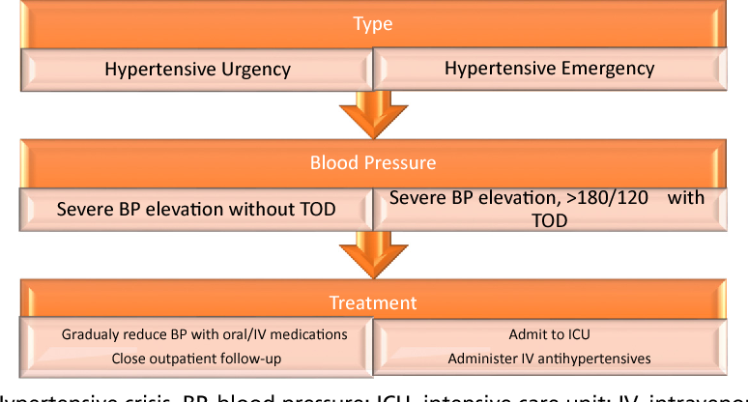

Slide 72
This nomenclature can lead to confusion because there is often no absolute distinction between the 2 situations, and treatment will often depend on clinical judgment.
Hypertensive encephalopathy (generalized or posterior reversible encephalopathy syndrome) is suggested by the presence of headache, vomiting, temperature elevation, visual disturbances, ataxia, depressed level of consciousness, imaging abnormalities, and seizures; it is one of the more common presentations of acute severe hypertension in children and adolescents.
Acute severe hypertension may also manifest with decreased vision (cortical blindness) and papilledema, congestive heart failure, or accelerated deterioration of renal function.

Slide 73
A stepwise reduction in pressure should be planned.
In general, BP should be reduced by no more than 25% of the planned reduction over the 1st 8 hr, with a gradual normalization of BPs over next 24-48 hr.
For patients with less severe symptoms, such as headache or nausea/vomiting, oral medications such as clonidine or isradipine can be used if the patient can tolerate oral medications.
Short-acting IV medications such as hydralazine or labetalol are acceptable if the patient cannot take oral drugs.

Slide 74
Treatment of secondary hypertension must also focus on the underlying disease, such as chronic renal disease, hyperthyroidism, pheochromocytoma, coarctation of the aorta, or renovascular hypertension.
The treatment of renovascular stenosis includes antihypertensive medications, angioplasty, or surgery.
If bilateral renovascular hypertension or renovascular disease in a solitary kidney is suspected, drugs acting on the RAAS are usually contraindicated because they may reduce glomerular filtration rate and lead to acute kidney injury.

Slide 75
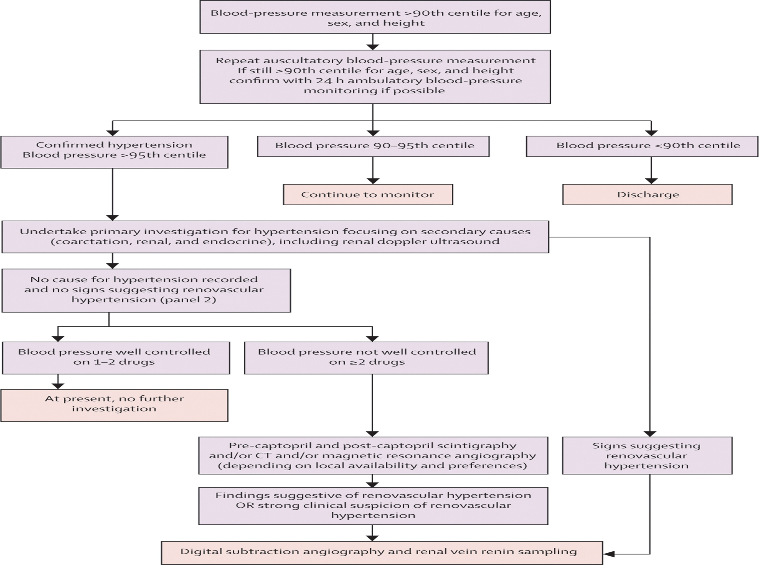

Slide 76
Thank u

